Slide 1

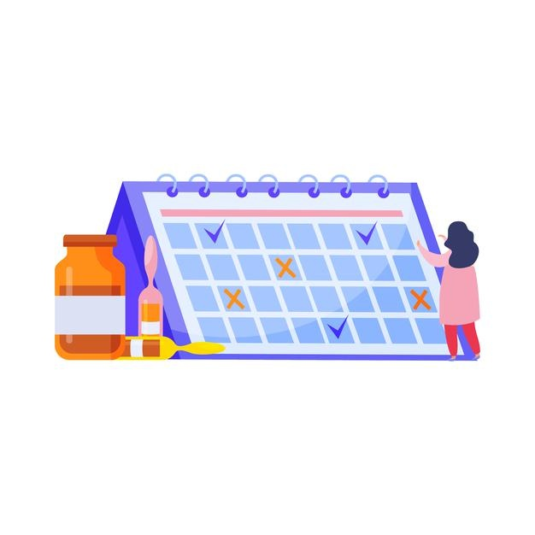
Agenda
Binding in SAP UI5
Expression Binding
Understand the use of Expression binding form an example
Binding Modes in SAP UI5
Introduction to Aggregation Binding
Creating a Table control
Creating a Dropdown List using the Aggregating Items

Slide 2
Binding in SAP UI5
Data binding is the process that establishes a connection between the application UI and business logic.
It is a bridge between a binding target and a binding source.
Property Binding
Expression Binding
Types of Binding in SAP UI5
Aggregation Binding
Element Binding
Property Binding:- When we bind property of a UI control, to the address of the model, this is called property binding. E.g. value property of Input control was connected to /emp/empId

Slide 3

Expression Binding
Expression binding : - When we bind an Expression ({= condition ? true : false}) with the property of a control rather binding value to a property, this is called expression binding.
If we need some calculation on model data or some sort of comparison, then expression binding is useful.
Syntax:
numberState = “{= ${path} > value ? ‘conditionForTrue’ : ‘ConditionForFalse’ }”
This saves the overhead of defining a function and is recommended in cases where the formatter function has a trivial implementation like comparison of values. Expression binding is especially useful in the context of SAPUI5 XML templating where XML views with templating are preprocessed so that the SAPUI5 controller is a natural place to put custom formatter functions that are not available.
Note: - To use expression binding, you need to enable extended binding syntax via the configuration setting in index.html file
data-sap-ui-bindingSyntax="complex"

Slide 4
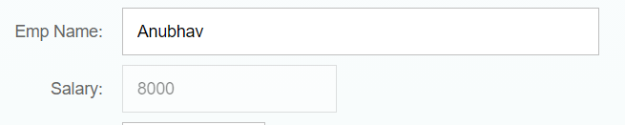
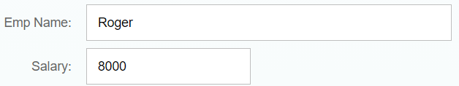
Use case of Expression Binding
My Manager want to add a button and when we click on that button, all the fields should gray out.
If The Employee Name is Anubhav, Gray out Salary field.
Condition – if employee name = Anubhav
Outcome – make field gray out
Target – Salary field
If Employee name = Anubhav
If Employee name != Anubhav

Slide 5

Exercise 1
In this exercise we will see the example of both property binding and expression binding.
In this file we also see that how to get data form the file in the model.
Exercise code:-
MyXML.controller.js
MyXML.view.xml

Slide 6
Binding Modes
There are basically three modes of binding data in SAPUI5.
One-way binding – Here, the data is transported in one direction only, i.e. from the model, through the binding instance to the consumer (usually the property of a control), but never in the other direction. Any change done on the model data from the front end is not affected to the model. All the data changes are reflected only on the controls.
Two-way binding – Here all input changes done from front end controls are reflected on the model and the backend database. SAPUI5 automatically handles the transport of data both from the model to the controls and back from the controls to the model.
One-time binding – Here all data will be bound from model to view just once. After that, the connection is no more set.

Slide 7
Aggregation Binding
When we bind the aggregation of a control with the entityset of data model, it is called aggregation Binding.
The parent control (e.g. Table) is bound to the EntitySet path which is called absolute path and the child of the parent Control (e.g. Columns) are connected to the child properties of the EntitySet is called relative path.
In aggregation binding, based on your model data, as many child controls will be created automatically.
Every Event of UI5 will trigger the eventHandler and we will get the Event Object as part of the event Handler. Depending on the event, the event handler object will have different parameters.
Use Case of Aggregation Binding
If we want to show a list or some data in tabular format, we need to bind a group of data. In such a case we will use aggregation binding.
Absolute path
{
“empTab”: [
{
“empId”: 50,
“empName”: “Jay”,
“salary”: 9500
}
]
}
Table = {/empTab}
Emp Id | Emp Name | Salary
{empId} | {empName} | {salary}
Relative Paths

Slide 8

Exercise 2
In this exercise we will bind the sample data with a table control.
To bind the table we will use aggregation bind.
In this we will also create a dropdown inside a cell in the table.
Exercise code:-
MyXML.view.xml
MyXML.controller.js

Slide 9

End of Day 8

Slide 10

Any Questions ?

Slide 11

Anubhav Oberoy

Slide 12
Title
Content

